Slide 1


Naviotech Training & Internship Project
Name : Chaitanya Mangla
Topic : Breast Cancer Classification Neural Networks Project

Slide 2


Neural Networks
A Neural Network is a Machine Learning Or Deep Learning Concept which is inspired by how the human brain works.
It is used to recognize the patterns, learn from the data and make predictions.
Just like the brain has neurons, the neural networks has artificial neurons connected together. They are arranged in layers like:
1. Input layer : Takes data in form of numbers, images and text.
2. Hidden Layers : Do calculations and learn patterns
3. Output Layer : Gives the final prediction and results.

Slide 3

Step by Step Working of the Neural Networks
Step by step working of the neural networks takes place as:
1. Data enters the network.
2. Each neuron multiplies the inputs by weight.
3. Adds the bias.
4. Passes through an activation function.
5. Output is produced.
6. Errors are calculated.
7. Weights are calculated by back propagation.

Slide 4

Back Propagation
Back Propagation refers to the technique in the neural networks which is a fundamental algorithm used to train the artificial neural networks by calculating the gradient of the loss of the functions with respect to the networks’ weights.
It calculates from the output layer moving backward, enabling efficient updatesto minimize errors and improve accuracy.
Basically, if we explain in one line, we can say that back propagation is an algorithm used to train neural networks by propagating the error backward and updating the weights to minimize the loss.

Slide 5
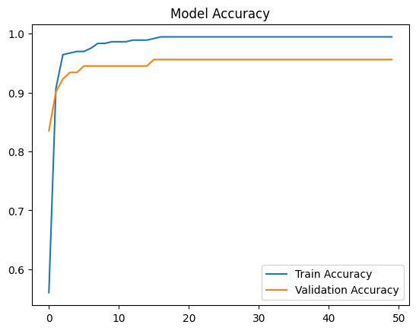
Model Accuracy graph

Slide 6
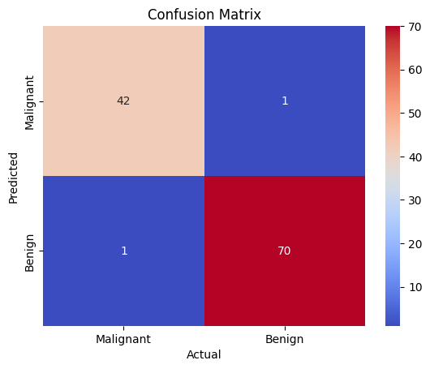
Confusion Matrix

Slide 7
Git Hub Link : Click Here

